Slide 1
Parallel Image Processing
Abdullah Algarni

Slide 2
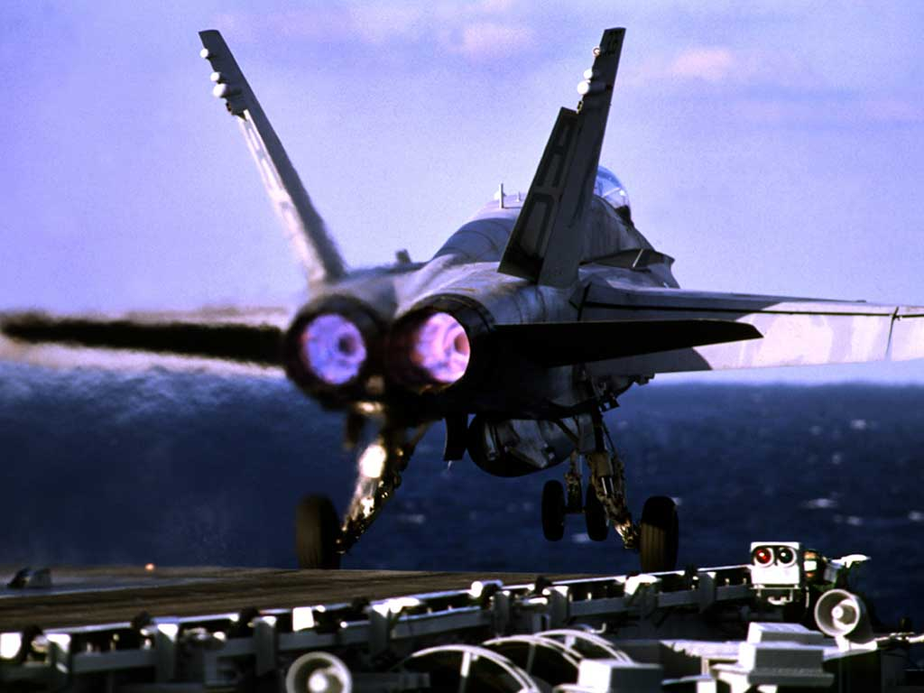
What is Digital image?
An image is a continuous function that has been discretized in spatial coordinates, brightness and color frequencies
Most often: 2-D with ‘pixels’ as scalar or vector value

Slide 3
Tour Guide
Image
Acquisition
Image
Generation
D.I.P.
Theme
Park
Image
Compression
Image
Manipulation
Image
Analysis
Image
Display
Image
Perception

Slide 4
Why D.I.P.?
Reasons for compression
Image data need to be accessed at a different time or location
Limited storage space and transmission bandwidth
Reasons for manipulation
Image data might experience non-ideal acquisition, transmission or display (e.g., restoration, enhancement and interpolation)
Image data might contain sensitive content (e.g., fight against piracy, or forgery)
To produce images with artistic effect (e.g., pointellism)
Reasons for analysis
Image data need to be analyzed automatically in order to reduce the burden of human operators
To teach a computer to “see” in A.I. tasks

Slide 5
Lossless Image Compression
Definition
Decompressed image will be mathematically
identical to the original one (zero error)
highly depends on the image type and content
Storage and transmission of medical images
Compression ratio
synthetic images
>10
photographic images
1~3
Applications

Slide 6
Popular Lossless Image
Compression Techniques
WinZip
Based on the celebrated Lempel-Ziv algorithm
invented nearly 30 years ago
Based on an enhanced version of LZ algorithm
by Welch in 1983
-Was introduced by CompuServe in 1987 and made
popular until it was not royalty-free in 1994
GIF (Graphic Interchange Format)
PNG (Portable Network Graphics)

Slide 7
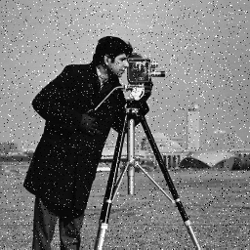

Image Manipulation : Noise Removal
Noise contamination is often inevitable during the acquisition

Slide 8
Image Manipulation : Deblurring
License plate is barely legible due to motion blurring

Slide 9
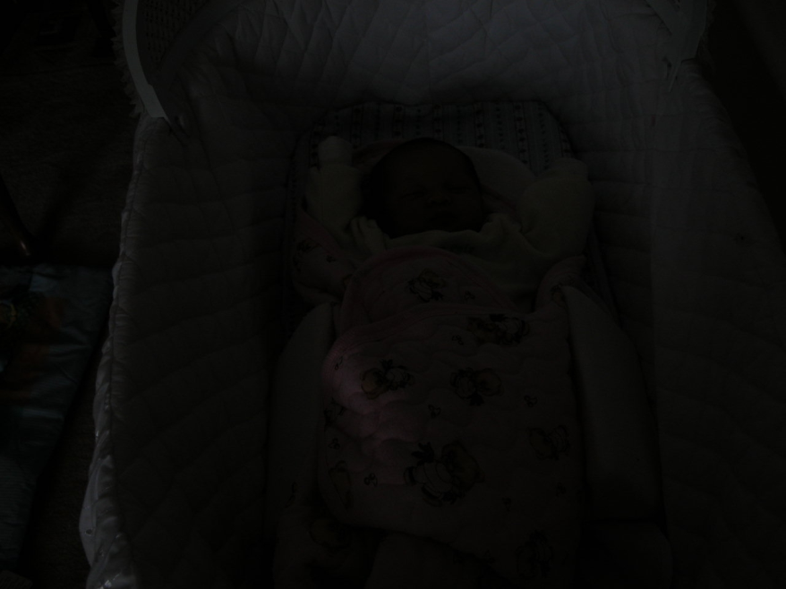
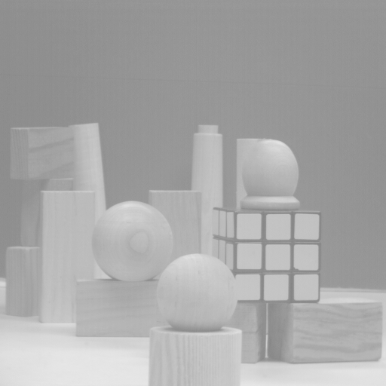
Image Manipulation: Contrast Enhancement
under-exposed image
overly-exposed image

Slide 10

Image Manipulation :
Image Interpolation
digital
zooming
small
1M pixels
large
4M pixels
Resolution enhancement can be obtained by common image
processing software such as Photoshop or Paint Shop Pro

Slide 11

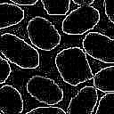
Image Analysis: Edge Detection

Slide 12
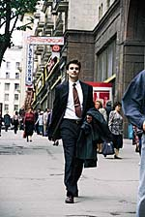
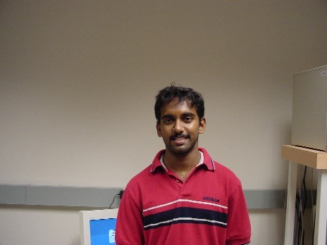
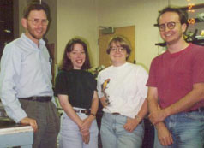
Image Analysis (II): Face Detection

Slide 13
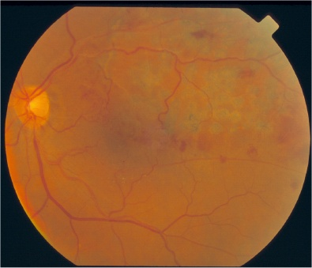
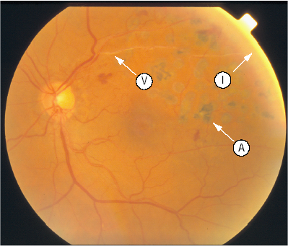
Change Detection in Medical Application

Slide 14
Image Analysis: Image Matching
Antemortem dental X-ray record
Postmortem dental X-ray record

Slide 15
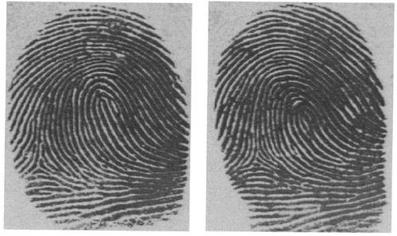
Image Matching in Biometrics
Two deceivingly similar fingerprints of two different people

Slide 16
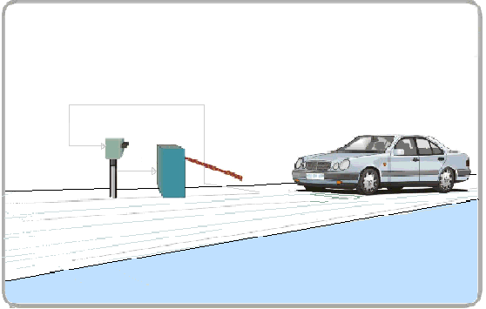
Image Analysis : Object Recognition
License number can be automatically
extracted from the image of license plate

Slide 17
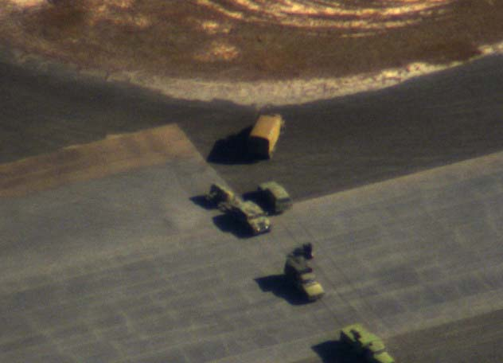
Object Recognition in Military Applications

Slide 18

Digital Image Fundamentals

Slide 19
Binary Images
Numerical example (image of a square block)
0 0 0 0 0 0 0 0
0 0 0 0 0 0 0 0
0 0 255 255 255 255 0 0
0 0 255 255 255 255 0 0
0 0 255 255 255 255 0 0
0 0 255 255 255 255 0 0
0 0 0 0 0 0 0 0
0 0 0 0 0 0 0 0

Slide 20
Smoothing Algorithm
What is the benefit of it?
Aim is to reduce noise
What is “noise”?
Noise is deviation of a value from its expected value
Random changes
x → x + n

Slide 21
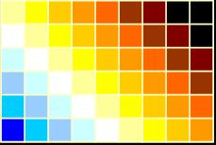
How to remove noise?
Using Median for each pixel and apply it for 3*3 mask
1 1 1 2 2 2 2 2 8 → median = 2
=
2 2 1
1 8 2
2 2 1
- - -
- 2 -
- - -

Slide 22
How to remove noise?
2) Using average for each pixel and apply it for 3*3 mask
(2+2+1+1+8+2+2+2+1)/9 → =2.3
=
2 2 1
1 8 2
2 2 1
- - -
- 2.3 -
- - -

Slide 23
After smoothing:

Slide 24
Sharpening and Edge Enhancement
What is edge detection?
Edge Detection is a process of identifying and marking points in an image at which the image intensity changes sharply
There are different algorithms to do that:
1) Sobel Operator 2) Prewitt Operator
3) Kirsch Operator 4) Homogeneity Operator 5) Difference Operator

Slide 25
How they work?
All of them have the same concept, Using different masks
+
=

Slide 26
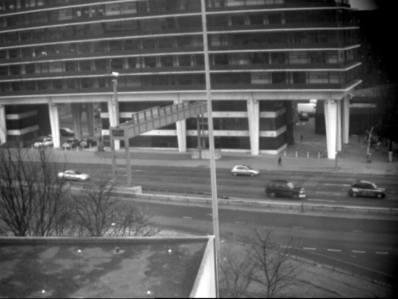
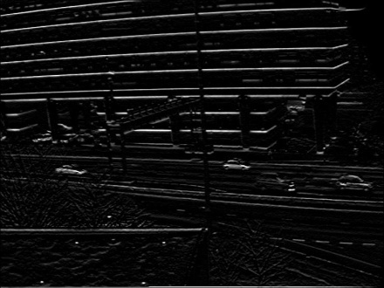
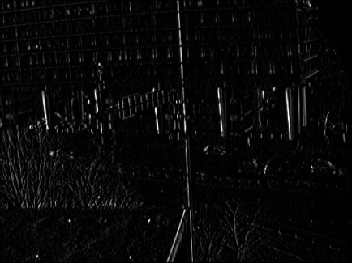
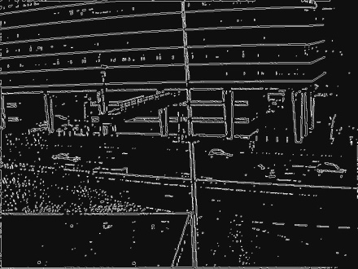
Prewitt/Sobel Edge Detector
-1 | -1 | -1
0 | 0 | 0
1 | 1 | 1
-1 | 0 | 1
-1 | 0 | 1
-1 | 0 | 1
Original
horizontal
vertical
both

Slide 27
Low Level Image Processing ‘Patterns’ (1)
=
Unary Pixel Operation
(example: absolute value)
+
=
Binary Pixel Operation
(example: addition)
N-ary Pixel Operation…
+
Template / Kernel / Filter /
Neighborhood Operation
(example: Gauss filter)
=

Slide 28

Low Level Image Processing ‘Patterns’ (2)
=
Reduction Operation
(example: sum)
2
1
7
6
4
=
N-Reduction Operation
(example: histogram)
+
M
=
Geometric Transformation
(example: rotation)
transformation matrix

Slide 29
Why Parallel Computing In Digital Image Processing ?

Slide 30
See the demo.

Slide 31
Why parallelism in imaging?
Many applications need to process incredible amount of image data in certain time:
Smaller timesteps,
more scales,
faster response times

Slide 32
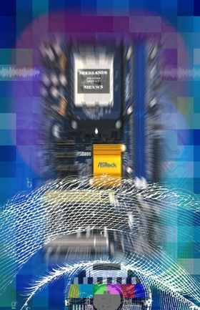
Multimedia
Multimedia = Text + Sound + Image + Video + ….
Video = image + image + image + ….
In many (not all) multimedia applications:
calculations are executed on each separate video frame independently
So: we focus on Image Processing (+ Computer Vision)

Slide 33
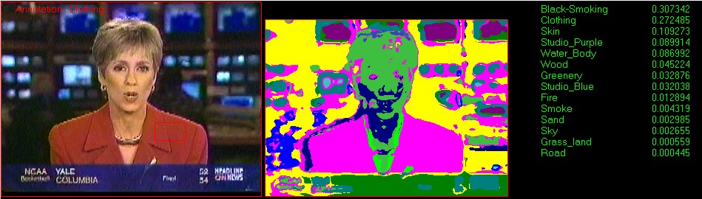
The ‘Need for Speed’ in P.I.P Research & Applications
A problem of scale:
At least 30-50 hours of processing time per hour of video
Beel&Geluid: 20,000 hours of TV broadcasts per year
NASA: over 1 TB of hyper-spectral image data per day
London Underground: over 120,000 years of processing…!!!

Slide 34
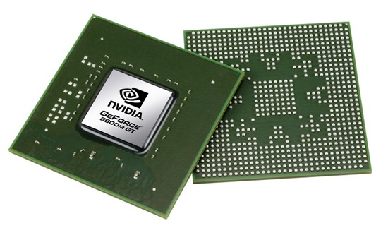
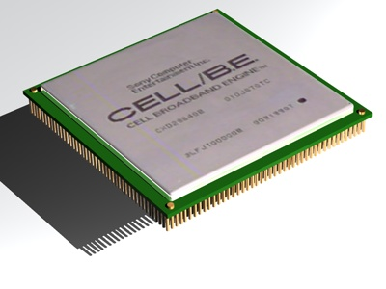
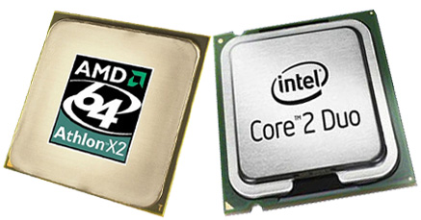
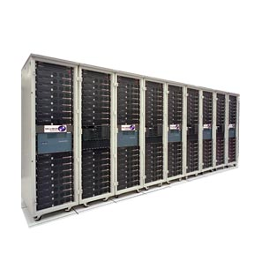

High-Performance Computing
GPUs
Accelerators
Solution:
Parallel & distributed computing at
a very large scale
General Purpose CPUs
Question:
What type of high-performance
hardware is most suitable?
Our initial choice:
Clusters of general purpose CPUs
(e.g. DAS-cluster)
Clusters
Grids

Slide 35
How Can Digital Image be processed in parallel way?

Slide 36
Many Low Level Imaging Algorithms are Embarrassingly Parallel
Parallel Operation on Image
{
Scatter Image (1)
Sequential Operation on Partial Image (2)
Gather Result Data (3)
}
On 2 CPUs:
(1)
(2)
(3)
Works (with minor issues) for unary, binary, n-ary operations & (n-) reduction operations

Slide 37
Other Imaging Algorithms Are More Complex (1)
Parallel Filter Operation on Image
{
Scatter Image (1)
Allocate Scratch (2)
Copy Image into Scratch (3)
Handle / Communicate Borders (4)
Sequential Filter Operation on Scratch (5)
Gather Image (6)
}
On 2 CPUs (without scatter / gather):
SCRATCH
SCRATCH
Also possible: ‘overlapping’ scatter
But not very useful in iterative filtering

Slide 38
Other Imaging Algorithms Are More Complex (2)
On 2 CPUs (rotation; without b-cast / gather):
Parallel Geometric Transformation on Image
{
Broadcast Image (1)
Create Partial Image (2)
Sequential Transform on Partial Image (3)
Gather Result Image (4)
}
RESULT
IMAGE
RESULT
IMAGE
Potential faster implementations for special cases

Slide 39
More Challenging: Separable Recursive Filtering (2 x 1-D)
+
2D Template / Kernel / Filter / Neighborhood Operation
(example: Gauss filter)
=
followed
by
+
=
+
=
Separable filters clearly reduces sequential computation time
Recursive filtering: result of each filter step (a pixel value) stored back into input image
So: a recursive filter re-uses (part of) its output as input

Slide 40
Parallel Recursive Filtering:
(GATHER)
(SCATTER)
(FILTER X-dir)
(FILTER Y-dir)
(TRANSPOSE)
Drawback: transpose operation is very expensive (esp. when nr. CPUs is large)

Slide 41
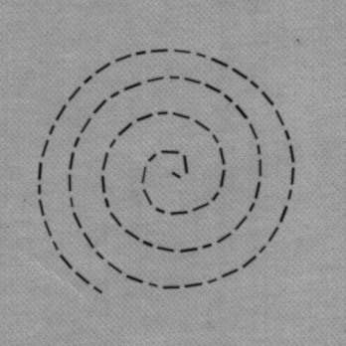
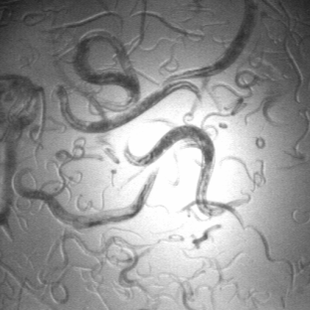

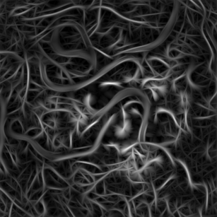
Example – Parallel Image Processing on Clusters
Apply anisotropic Gaussian filter bank to input image
Maximum response when filter tuned to line direction
Here 3 different implementations
fixed filters applied to a rotating image
rotating filters applied to fixed input image
separable (UV)
non-separable (2D)
Depending on parameter space:
few minutes - several hours
( the study done by Vrije University)

Slide 42
Sequential = parallel
for all orientations theta {
geometricOp ( inputIm, &rotatIm, -theta, LINEAR, 0, p, “rotate” );
for all smoothing scales sy {
for all differentiation scales sx {
genConvolution ( filtIm1, mirrorBorder, “gauss”, sx, sy, 2, 0 );
genConvolution ( filtIm2, mirrorBorder, “gauss”, sx, sy, 0, 0 );
binaryPixOpI ( filtIm1, filtIm2, “negdiv” );
binaryPixOpC ( filtIm1, sx*sy, “mul” );
binaryPixOpI ( contrIm, filtIm1, “max” );
}
}
geometricOp ( contrIm, &backIm, theta, LINEAR, 0, p, “rotate” );
binaryPixOpI ( resltIm, backIm, “max” );
} IMPLEMENTATION 1

Slide 43
Sequential = parallel
for all orientations theta {
for all smoothing scales sy {
for all differentiation scales sx {
genConvolution (filtIm1, mirrorBorder, “func”, sx, sy, 2, 0 );
genConvolution (filtIm2, mirrorBorder, “func”, sx, sy, 0, 0 );
binaryPixOpI (filtIm1, filtIm2, “negdiv”);
binaryPixOpC (filtIm1, sx*sy, “mul”);
binaryPixOpI (resltIm, filtIm1, “max”);
}
}
}
IMPLEMENTATIONS 2 and 3

Slide 44
Measurements on DAS-1
512x512 image
36 orientations
8 anisotropic filters
So: part of the efficiency of parallel execution always remains in the hands of the application programmer!
( the study done by Vrije University)

Slide 45
Measurements on DAS-2
512x512 image
36 orientations
8 anisotropic filters
So: lazy parallelization (or: optimization across library calls) is very important for high efficiency!

Slide 46
Resources:
Parallel Image Processing by Quantitative Imaging Group
Digital Image Processing by Rafael Gonzalez, and Richard Wood.
Multimedia Content Analysis on Clusters and Grids by Frank J. Seinstra
Tutorial in Data Parallel Image Processing by Thomas Bräunl

Slide 47
Q: What are two algorithms that we can use to remove noise from the image and how they work?

Slide 48
How to remove noise?
1) Using Median for each pixel and apply it for 3*3 mask
1 1 1 2 2 2 2 2 8 → median = 2
=
2 2 1
1 8 2
2 2 1
- - -
- 2 -
- - -

Slide 49
2) Using average for each pixel and apply it for 3*3 mask
(2+2+1+1+8+2+2+2+1)/9 → =2.3
=
2 2 1
1 8 2
2 2 1
- - -
- 2.3 -
- - -

Slide 50
Any Question?

